Slide 1

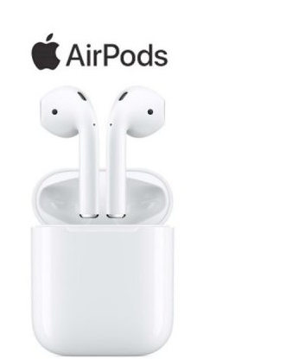
Apple AirPods
By: Nathaniel Kelly and
Seth Uthayakumar

Slide 2

Company analysis
Apple products are user friendly to attract more consumers
Air Pods have a unique design to create comfort and limit physical restrictions.
Given the features and advantages that our product provides we expect to consumers to purchase our product

Slide 3
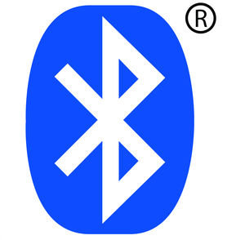
Industry Information
Growing Industry, Bluetooth headphones Introduced not to long ago
These products are become more commonly used rather then wired headphones and have strong scope in the future

Slide 4

Prospect Company Knowledge
Formerly known as Sound of Music
Founded in 1966
Won the Forbes company of the year in 2004

Slide 5
Our Prospect Needs
Slow sales of Bluetooth headphones are caused by battery durability and discomfort
Our New product eliminates these disadvantages
Increase sales and sell Bluetooth products on shelf

Slide 6
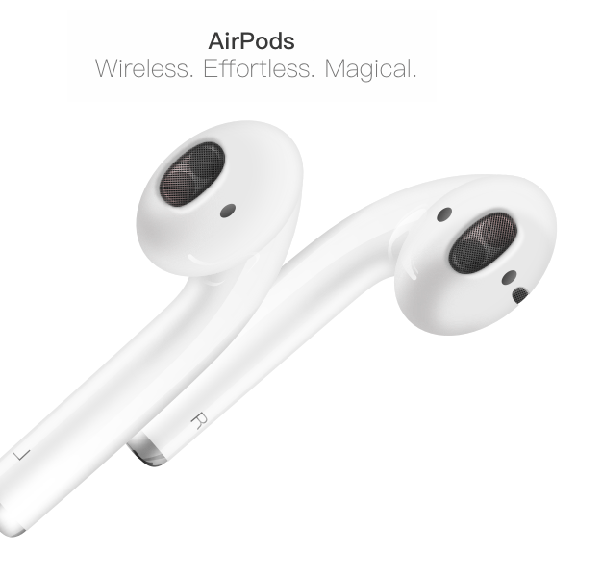
Unique Value Proposition(UVP)
The headphone industry tends to move to wireless headphones however sales are still slow.
Our new Air pod address all the disadvantages of wireless headphones.
By choosing our product we will increase your sales significantly.
Notes:
-

Slide 7
Advantages of Our Product
Save electricity and time
Ear buds can always be found if it were lost
Instant solution for battery dead headphones
Comfort from our design

Slide 8
Features of Our Product
Rechargeable case
W1 chip for easy impairment
Magnetic Infrared Sensory
Completely wireless
Double tap feature

Slide 9
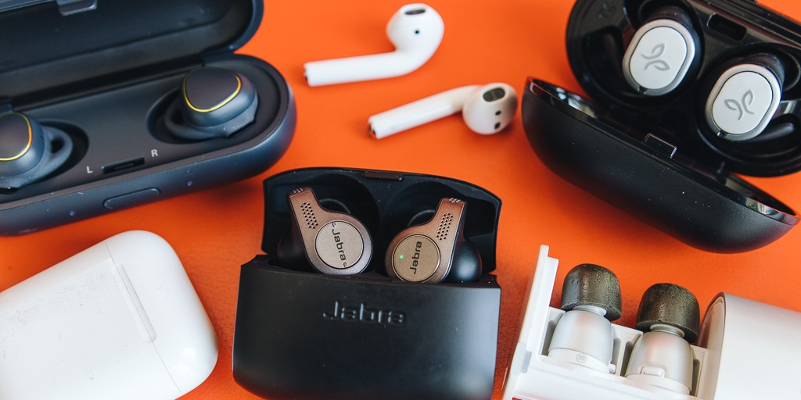
Top Competitors &Competitive Knowledge
Some of our competitors are Bose, Sony and Plantronics,
Potential customers that consider Bluetooth headphones from our competition.
Our competitive advantage?
Notes:
Plantronics Backbeat FIT 1200 149.99 sweat-proof and water proof 8hrs
Sony WH100XM3 $348 30hrs
Bose SoundSport free 5hrs $250 (completely wireless)

